Slide 1



Attention in Aversive Choice: Sequential Sampling Over Reference-Dependent Value Signals
Brenden Eum
Stephen Gonzalez
Antonio Rangel

Slide 2
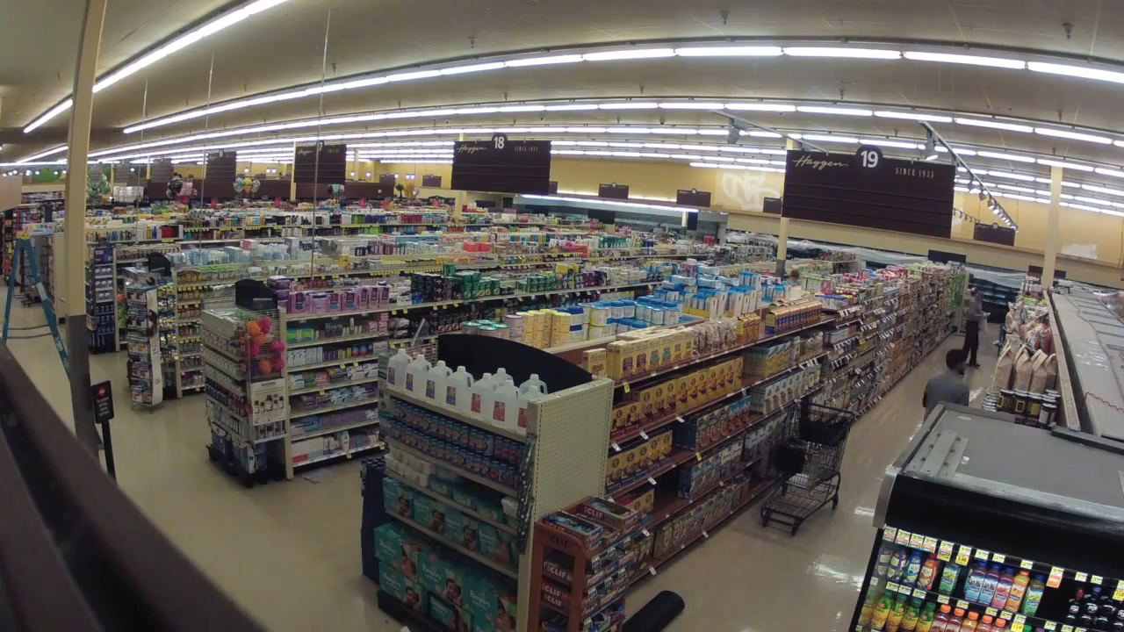


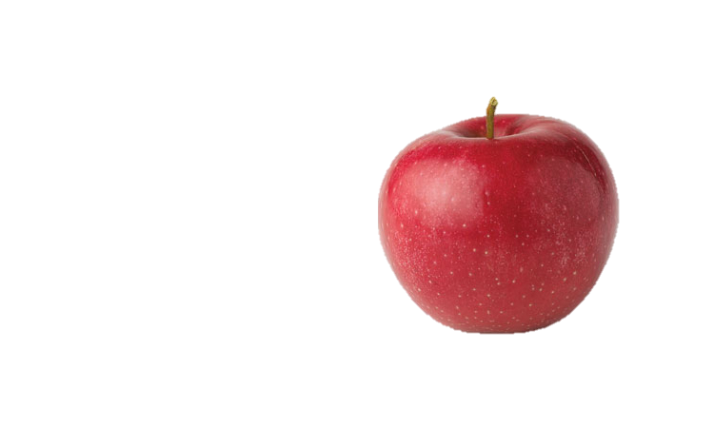

Slide 3
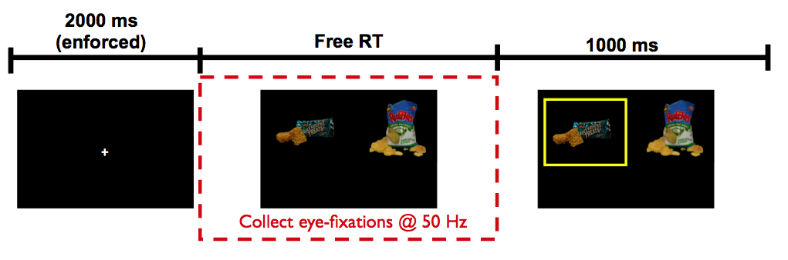
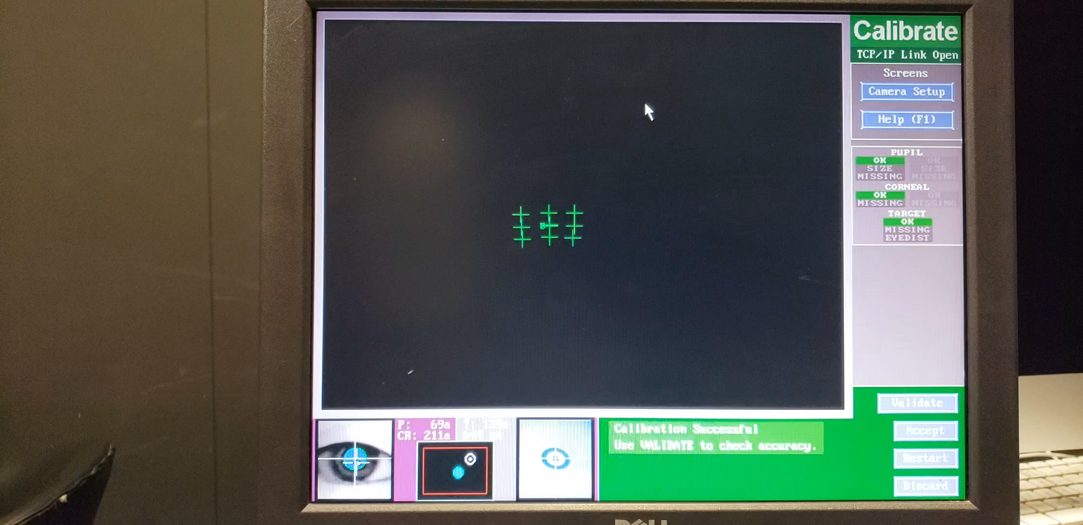
Krajbich, Armel, Rangel (2010, Nat Neuro)

Slide 4
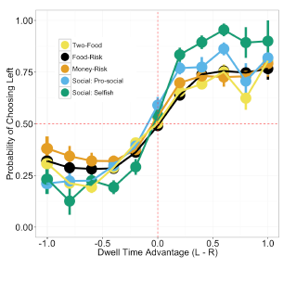
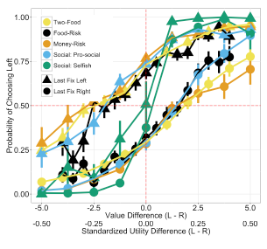
Net Fixation Bias
Last Fixation Bias
Smith, Krajbich (2018, J Exp Psychol Gen)
Notes:
multiple domains

Slide 5
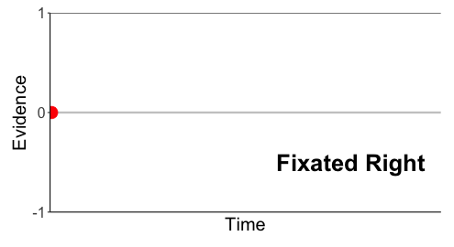
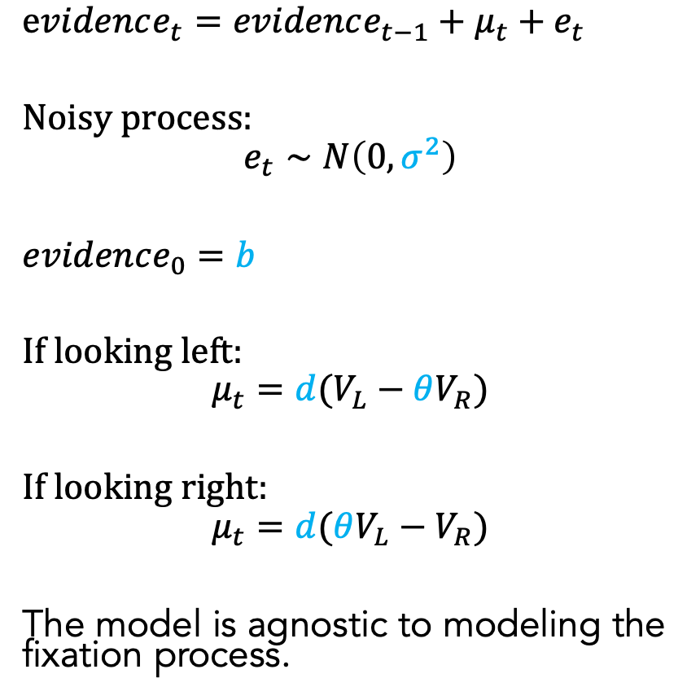
Attentional Drift-Diffusion-Model (aDDM)
$evidence_{t}=evidence_{t−1}+μ_{t}+e_{t}$
Noisy process:
$$e_{t}∼N\left(0, σ^{2}\right)$$
$evidence_{0}=b$
If looking left:
$$μ_{t}=d(V_{L}−θV_{R})$$
If looking right:
$$μ_{t}=d(θV_{L}−V_{R})$$
The model is agnostic to modeling the fixation process.
Pick Left
Pick Right
Notes:
noisy
bias
drift: ddm in value based decisions: evidence accumulated is value comparison
drift
sim
explain fixation sampling process

Slide 6
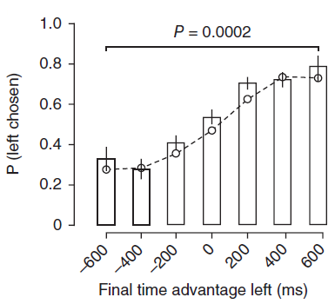
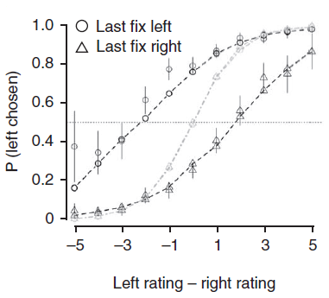
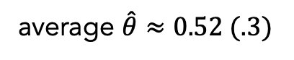
aDDM Predictions
average $\hat{θ}≈0.52 (.3)$
1. Attentional Discounting
2. Net Fixation Bias
3. Last Fixation Bias
Krajbich, Armel, Rangel (2010, Nat Neuro)
Krajbich, Armel, Rangel (2010, Nat Neuro)

Slide 7
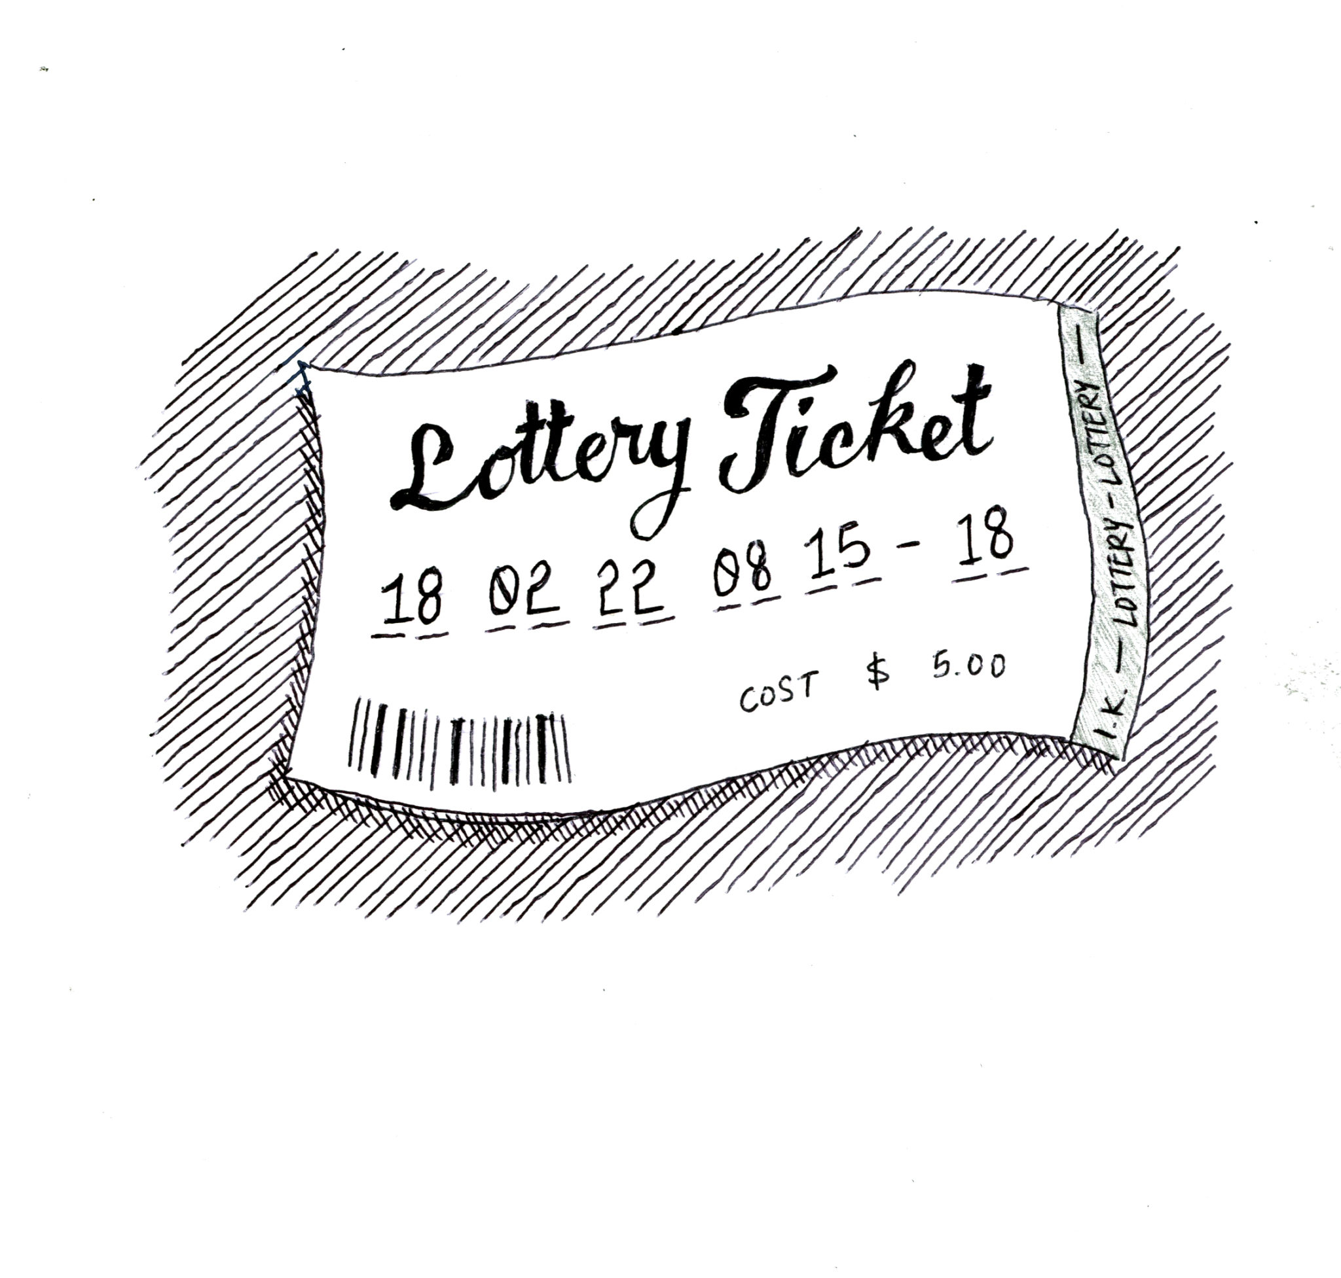
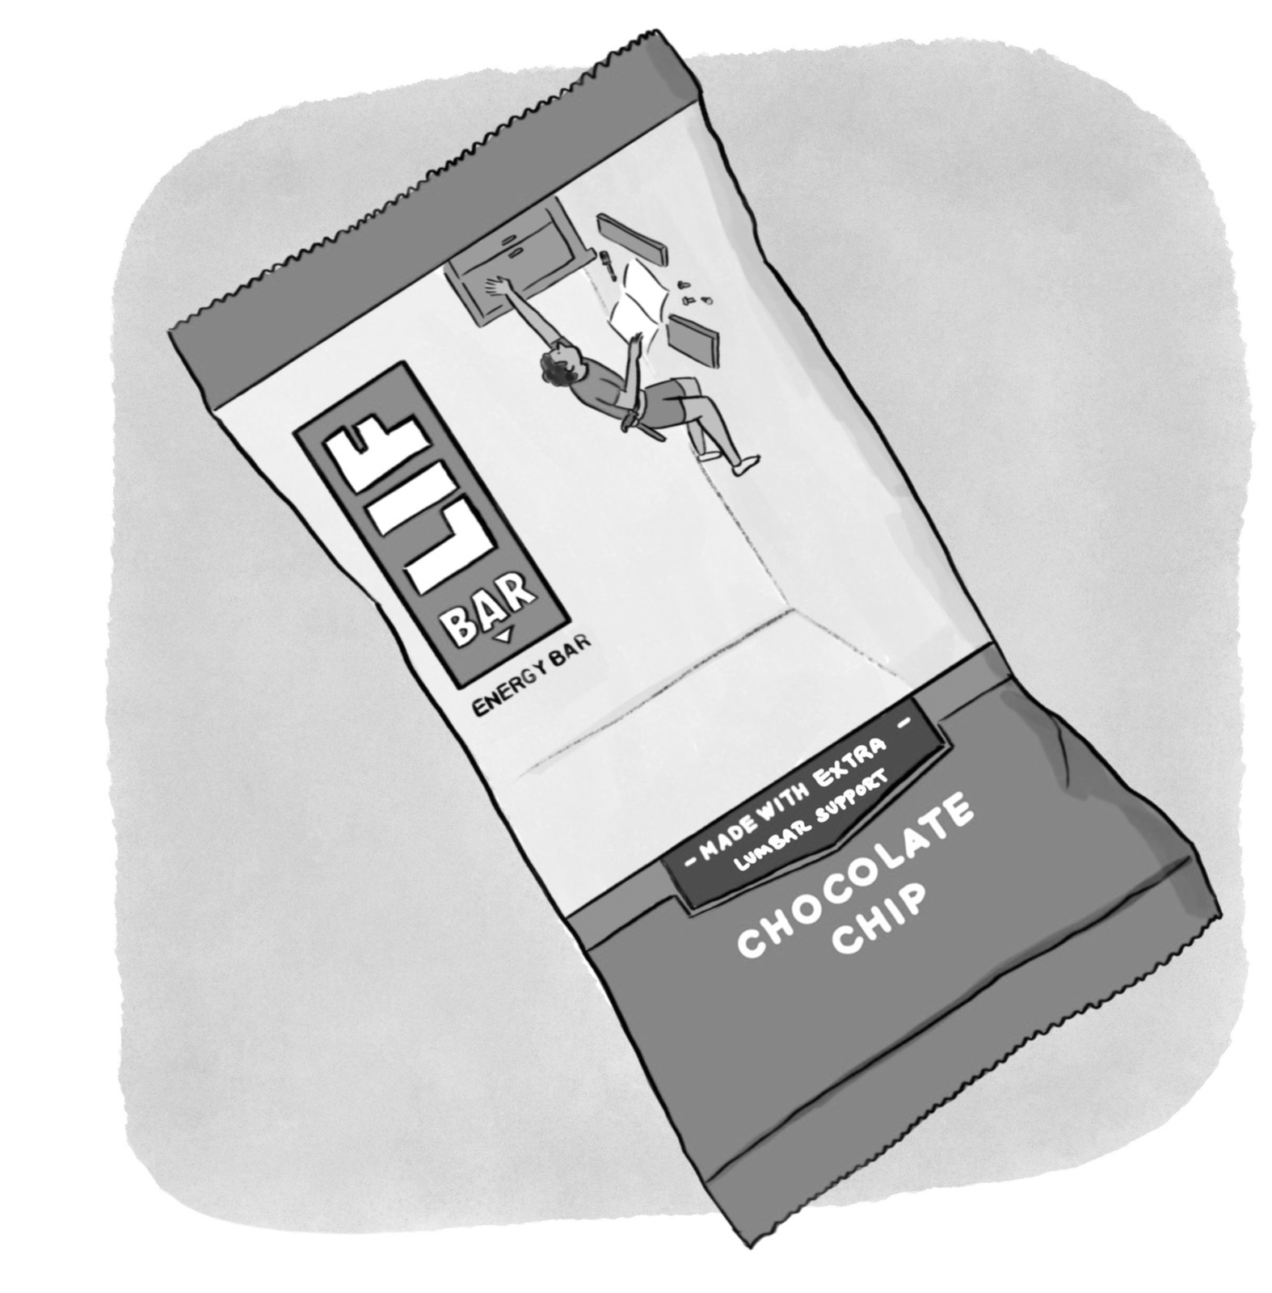
0
See Smith, Krajbich (2018, J Exp Psychol Gen); Bhatnagar, Orquin (2022, J Exp Psychol Gen); Fiedler, Glöckner (2012, Front Psychol)
Brenden Eum

Slide 8
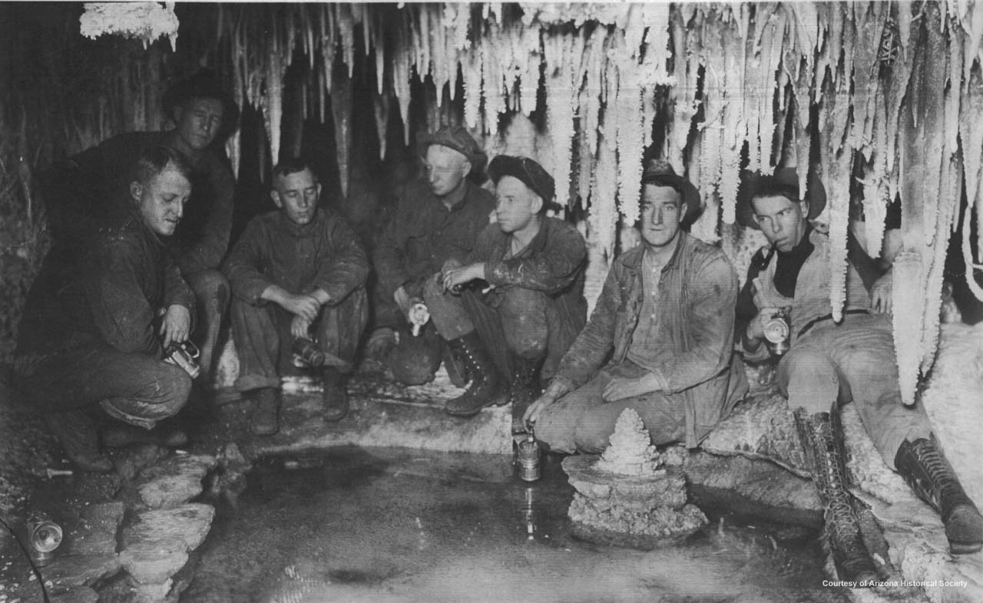
0
Copper Miners in Bisbee, Arizona
Brenden Eum

Slide 9
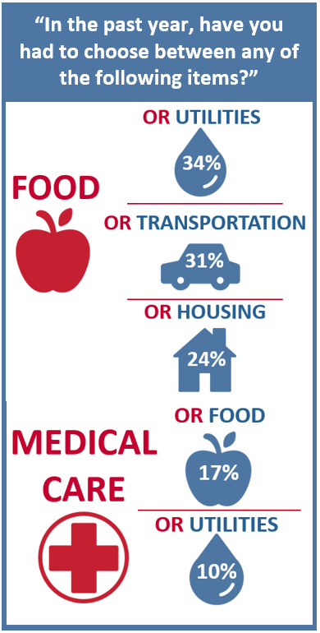
The Center for Community Solutions, Cleveland, Ohio

Slide 10
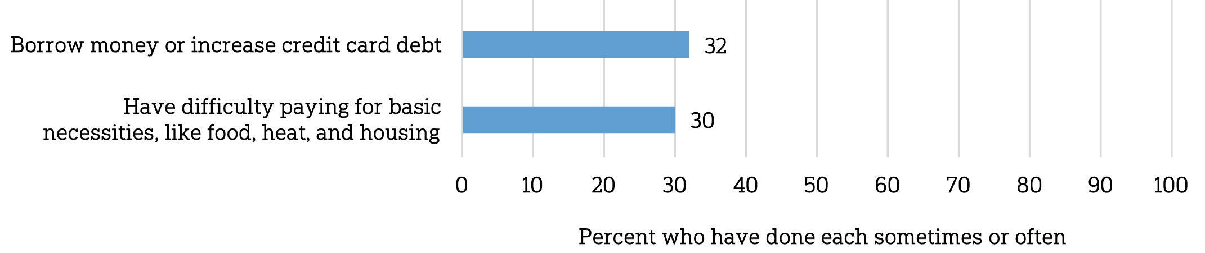
Does paying for healthcare costs cause you to…
The Center for Community Solutions, Cleveland, Ohio
NORC @ U Chicago / West Health Institute (2018)
Notes:
Aversive choices can have extremely large consequences. Is attention causing people to make mistakes?

Slide 11

Does paying for healthcare costs cause you to…
How does attention affect our choice process in aversive choices?
The Center for Community Solutions, Cleveland, Ohio
NORC @ U Chicago / West Health Institute (2018)
Notes:
Aversive choices can have extremely large consequences. Is attention causing people to make mistakes?

Slide 12
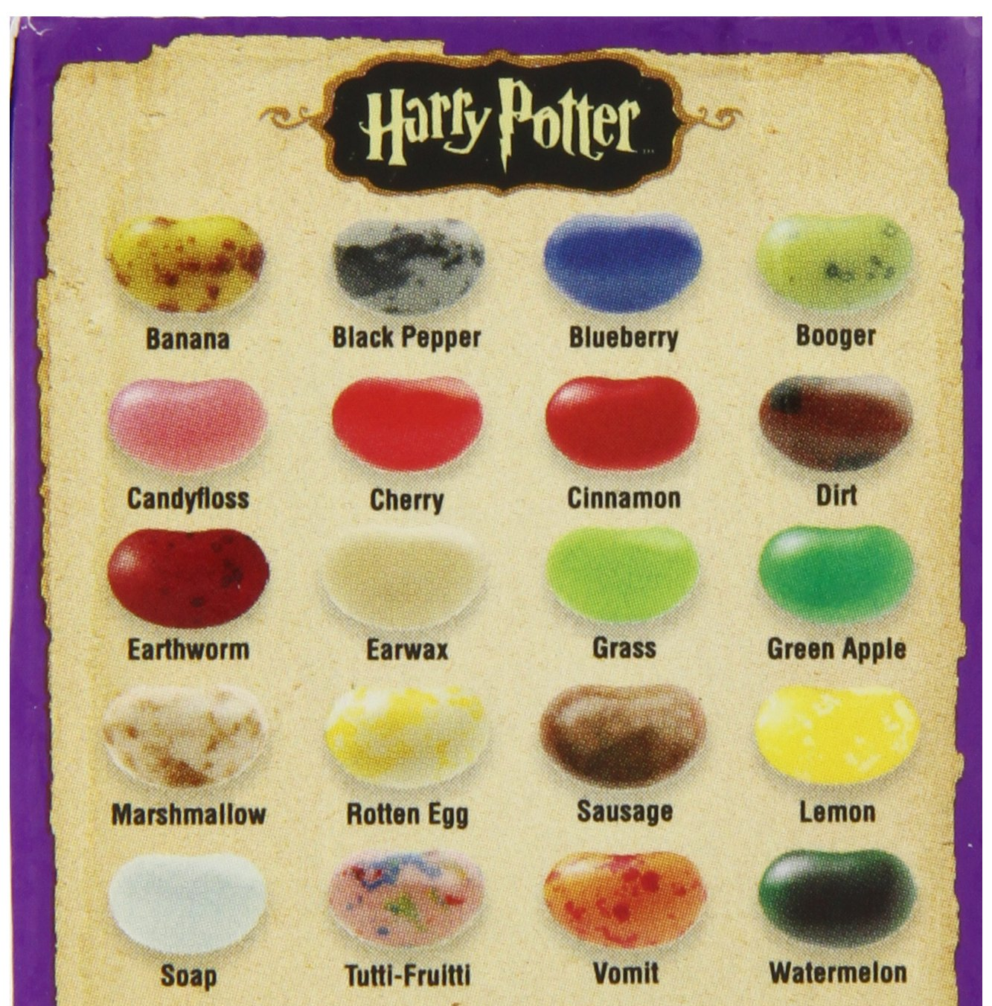
aDDM Prediction

Slide 13
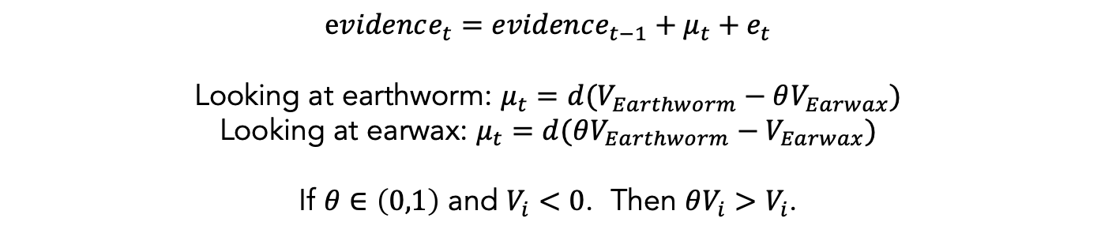
$evidence_{t}=evidence_{t−1}+μ_{t}+e_{t}$
Looking at earthworm: $μ_{t}=d(V_{Earthworm}−θV_{Earwax})$
Looking at earwax: $μ_{t}=d(θV_{Earthworm}−V_{Earwax})$
If $θ∈\left(0,1\right)$ and $V_{i}<0$. Then $θV_{i}>V_{i}$.

Slide 14
$evidence_{t}=evidence_{t−1}+μ_{t}+e_{t}$
Looking at earthworm: $μ_{t}=d(V_{Earthworm}−θV_{Earwax})$
Looking at earwax: $μ_{t}=d(θV_{Earthworm}−V_{Earwax})$
If $θ∈\left(0,1\right)$ and $V_{i}<0$. Then $θV_{i}>V_{i}$.
If attentional discounting persists in choices between losses,
then the value of the nonfixated option should seem less negative
(i.e. better than it actually is).

Slide 15
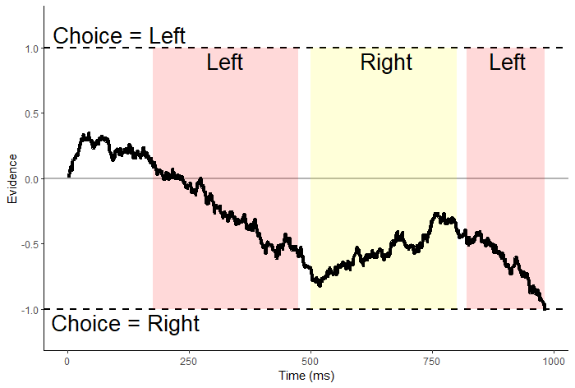
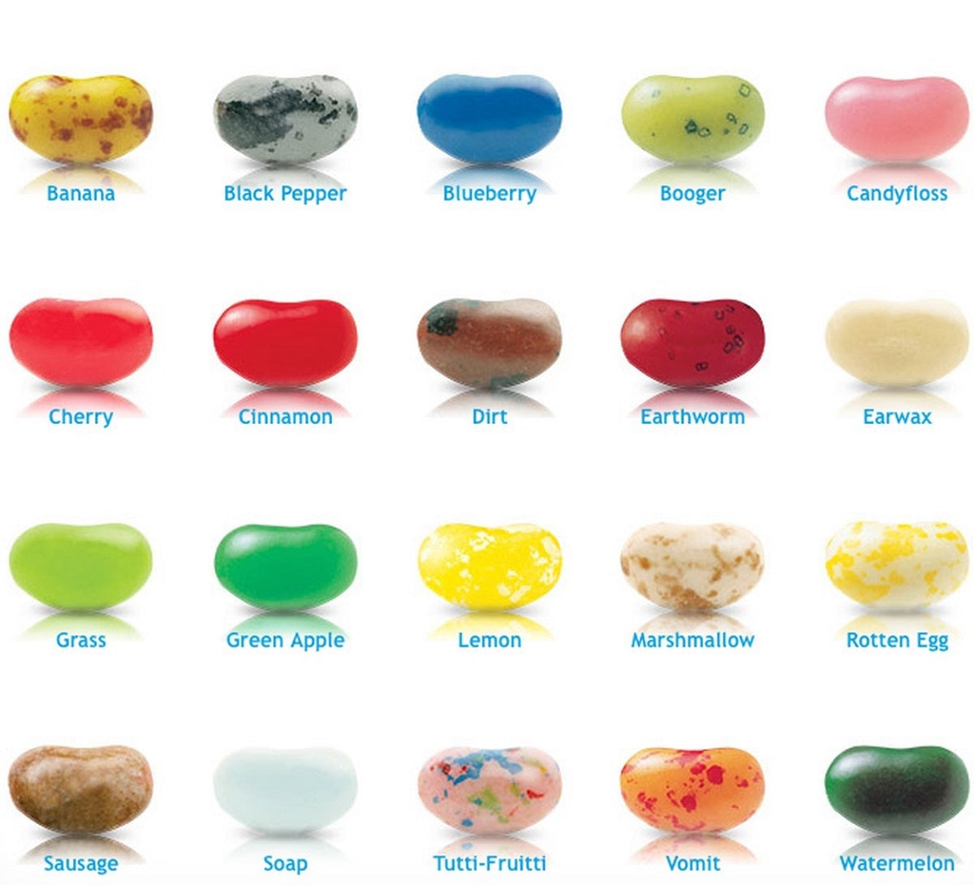
$evidence_{t}=evidence_{t−1}+μ_{t}+e_{t}$
Looking at earthworm: $μ_{t}=d(V_{Earthworm}−θV_{Earwax})$
Looking at earwax: $μ_{t}=d(θV_{Earthworm}−V_{Earwax})$
If $θ∈\left(0,1\right)$ and $V_{i}<0$. Then $θV_{i}>V_{i}$.
If attentional discounting persists in choices between losses,
then the value of the nonfixated option should seem less negative
(i.e. better than it actually is).

Slide 16
Attentional choice biases
Net Fixation Bias
Last Fixation Bias
Pr(Left Chosen)
Pr(Choose Last Fix.)
Final Time Advantage Left
Left Rating - Right Rating

Slide 17
Attentional choice biases
should flip!
Net Fixation Bias
Last Fixation Bias
Pr(Left Chosen)
Pr(Choose Last Fix.)
Final Time Advantage Left
Left Rating - Right Rating

Slide 18
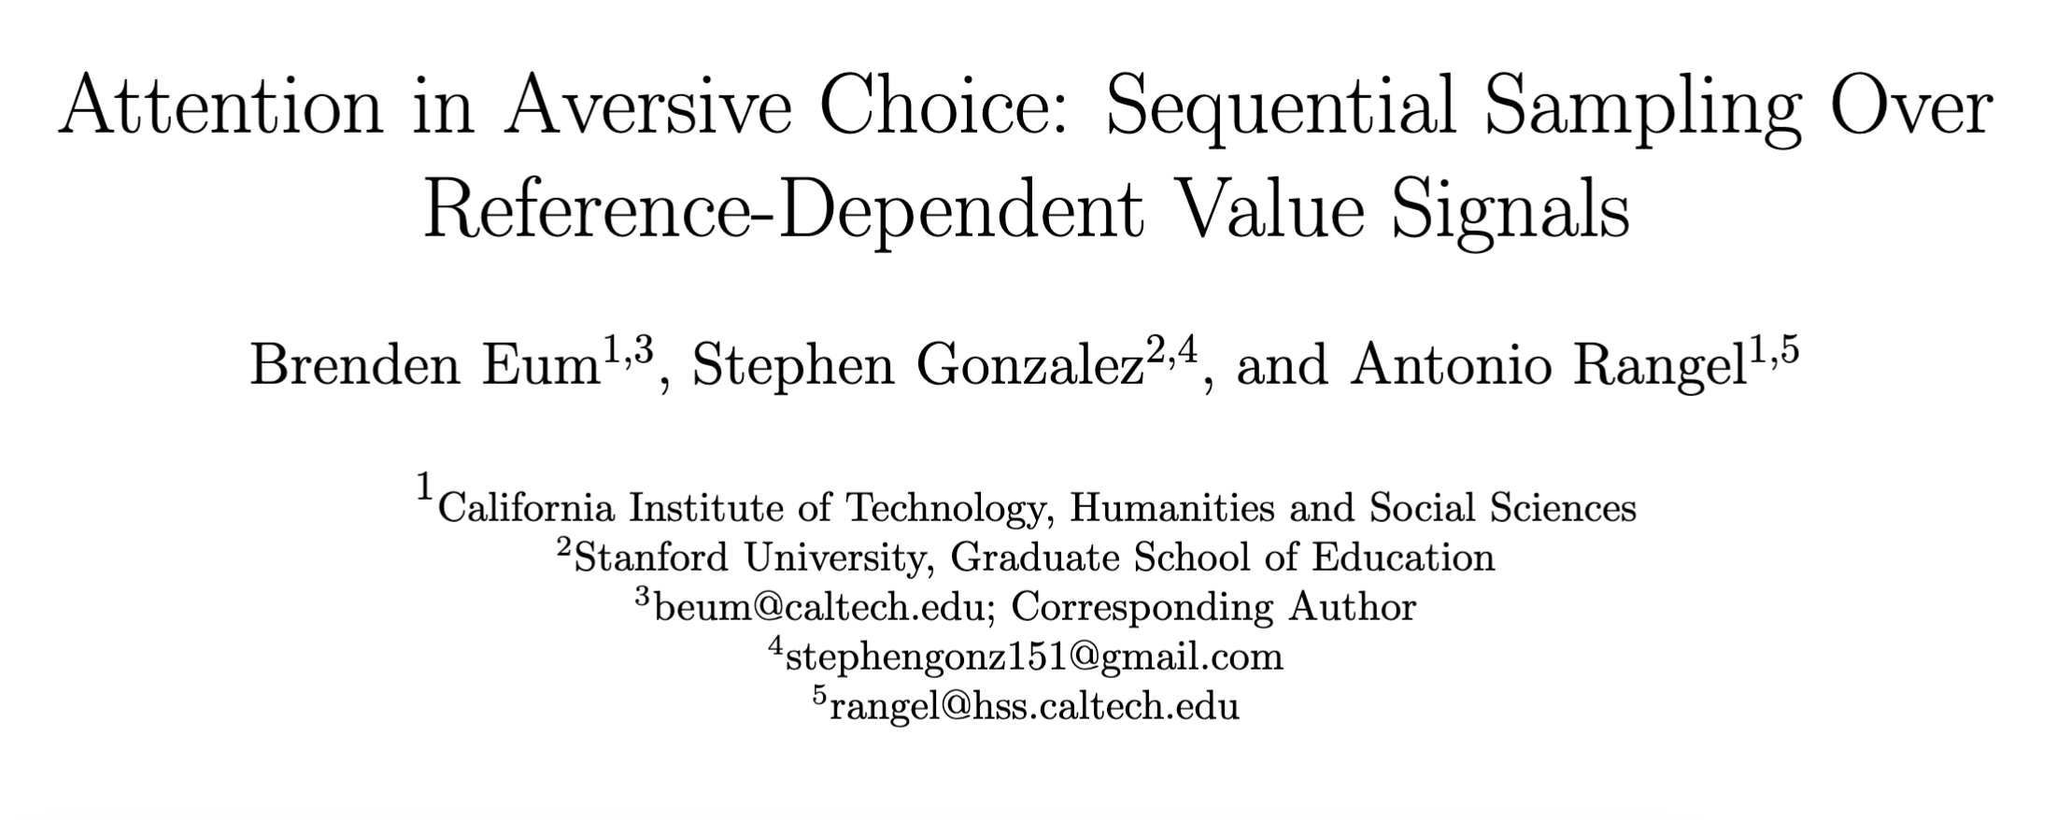

Slide 19
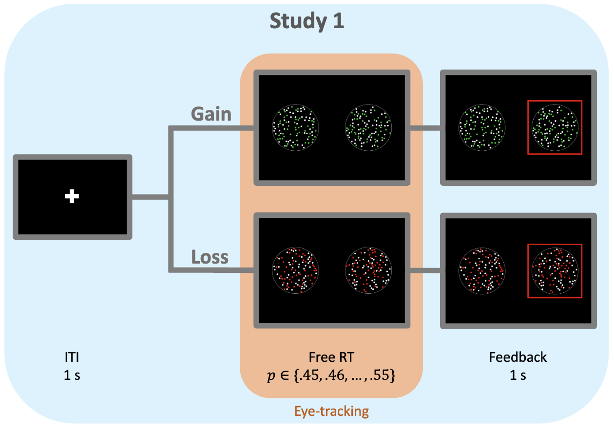

Slide 20
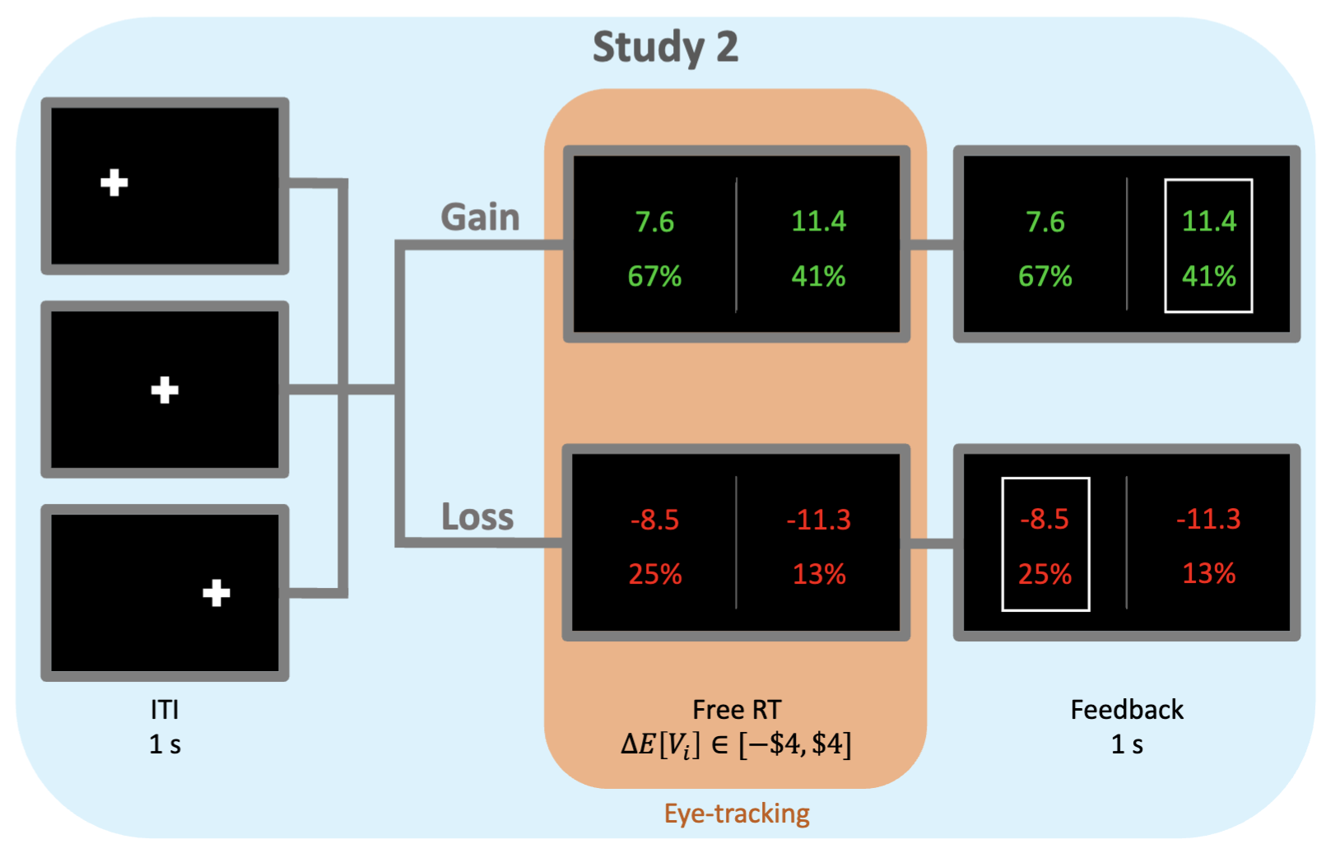

Slide 21
Attention in Risky Gains
Attention in Losses
Net Fixation Bias
Fiedler, Glockner (2012, Front Psych)
Smith, Krajbich (2018, J Exp Psych)
Stewart, Hermens, Matthews (2016, JBDM)
Last Fixation Bias
Smith, Krajbich (2018, J Exp Psych)
Brandstatter, Korner (2014, Acta Psych)
Mixed evidence for role of attention.

Slide 22
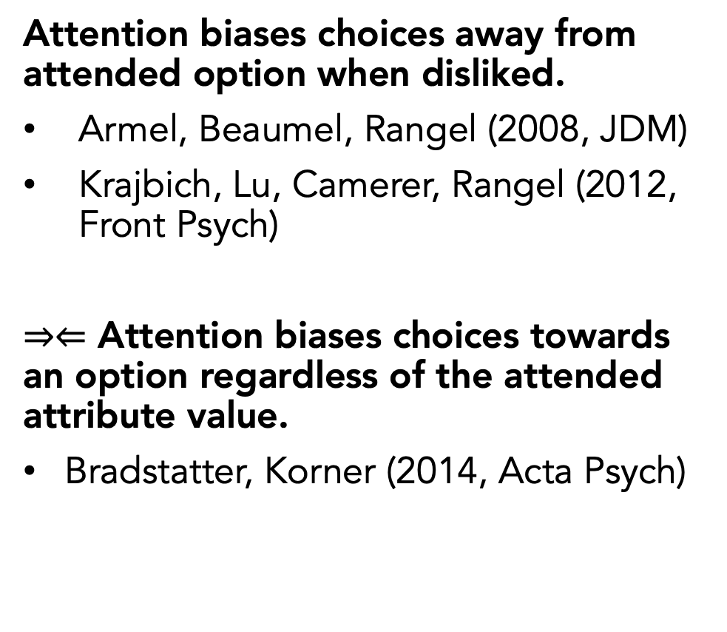
Attention in Risky Gains
Attention in Losses
Net Fixation Bias
Fiedler, Glockner (2012, Front Psych)
Smith, Krajbich (2018, J Exp Psych)
Stewart, Hermens, Matthews (2016, JBDM)
Last Fixation Bias
Smith, Krajbich (2018, J Exp Psych)
Brandstatter, Korner (2014, Acta Psych)
Mixed evidence for role of attention.
Attention biases choices away from attended option when disliked.
Armel, Beaumel, Rangel (2008, JDM)
Krajbich, Lu, Camerer, Rangel (2012, Front Psych)
$⇒⇐$ Attention biases choices towards an option regardless of the attended attribute value.
Bradstatter, Korner (2014, Acta Psych)

Slide 23
Basic Psychometrics

Slide 24
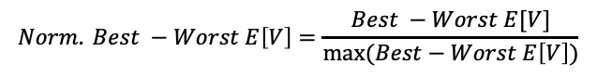
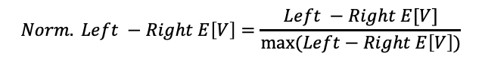
Basic Psychometrics
$$Norm. Left −Right E\left[V\right]=\frac{Left −Right E[V]}{max⁡(Left−Right E\left[V\right])}$$
$$Norm. Best −Worst E\left[V\right]=\frac{Best −Worst E[V]}{max⁡(Best−Worst E\left[V\right])}$$

Slide 25
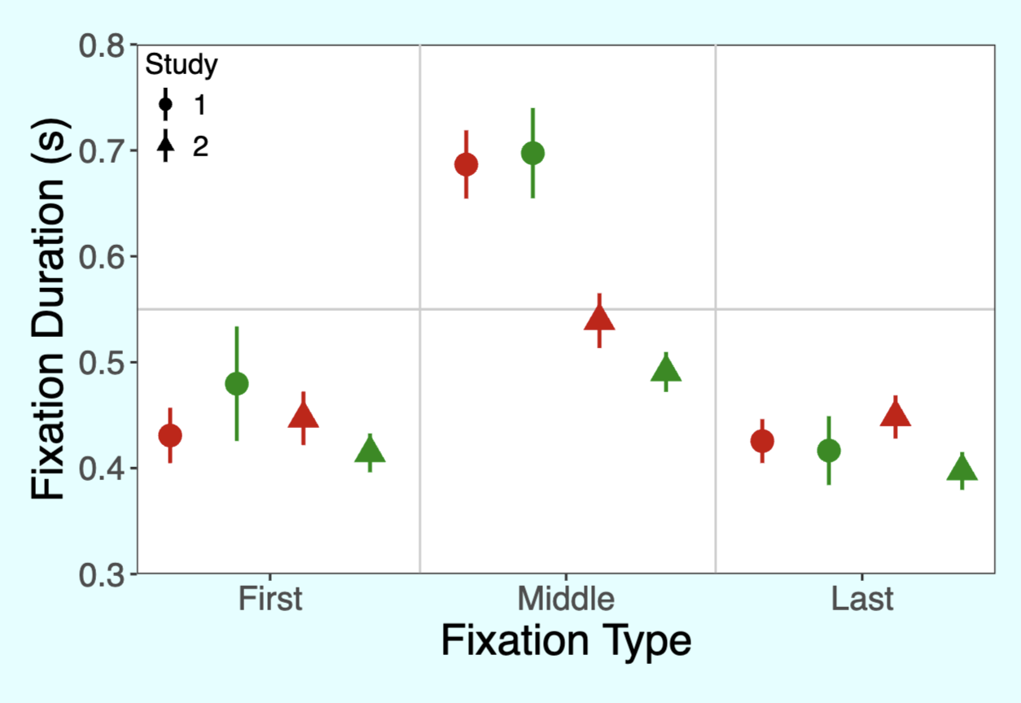
Fixation Process

Slide 26
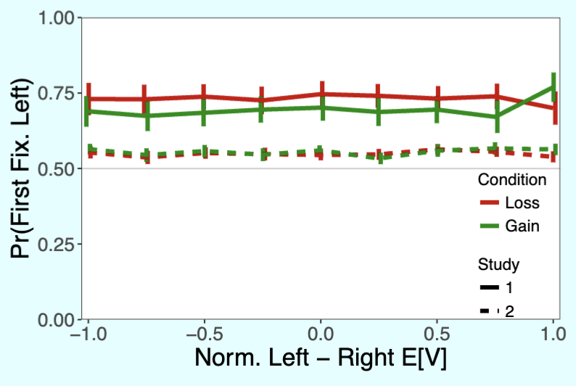
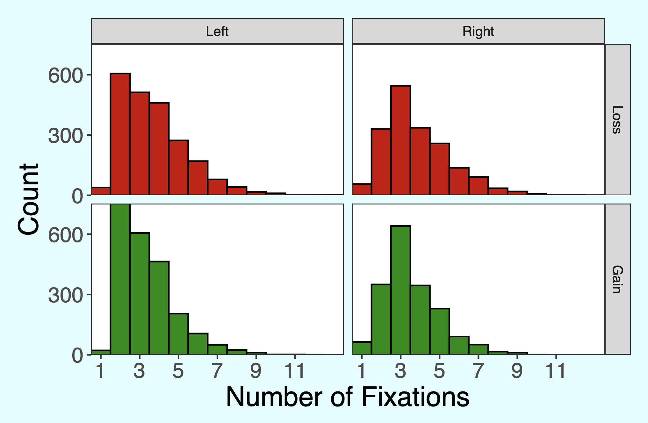
Why the right-hand-side fixation bias in study 2?
Study 2

Slide 27
Predicted Attentional Choice Bias Reversals
Net Fixation Bias
Last Fixation Bias
Pr(Left Chosen)
Pr(Choose Last Fix.)
Final Time Advantage Left
Left Rating - Right Rating

Slide 28
No Attentional Choice Bias Reversals
Net Fixation Bias
Last Fixation Bias
Pr(Left Chosen)
Pr(Choose Last Fix.)
Final Time Advantage Left
Left Rating - Right Rating

Slide 29
No Attentional Choice Bias Reversals
Net Fixation Bias
Last Fixation Bias
Pr(Left Chosen)
Pr(Choose Last Fix.)
Final Time Advantage Left
Left Rating - Right Rating

Slide 30
No Attentional Choice Bias Reversals
Net Fixation Bias
Last Fixation Bias
Pr(Left Chosen)
Pr(Choose Last Fix.)
How can we reconcile these results with the aDDM?
Final Time Advantage Left
Left Rating - Right Rating

Slide 31
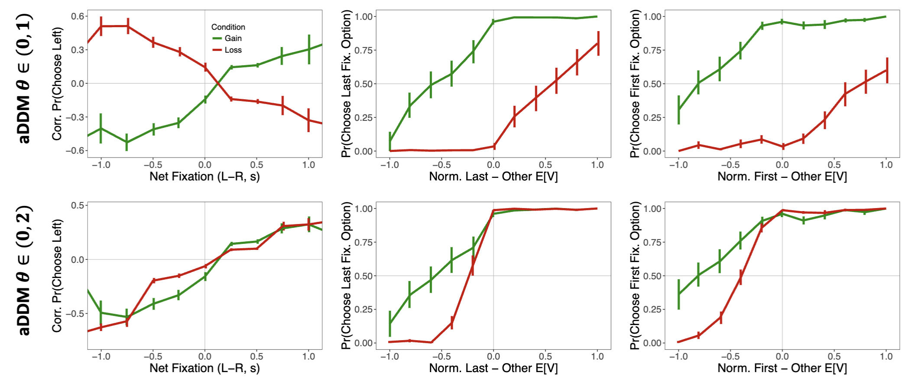
Simulations show it is impossible with $θ∈(0,1)$.
Simulations

Slide 32
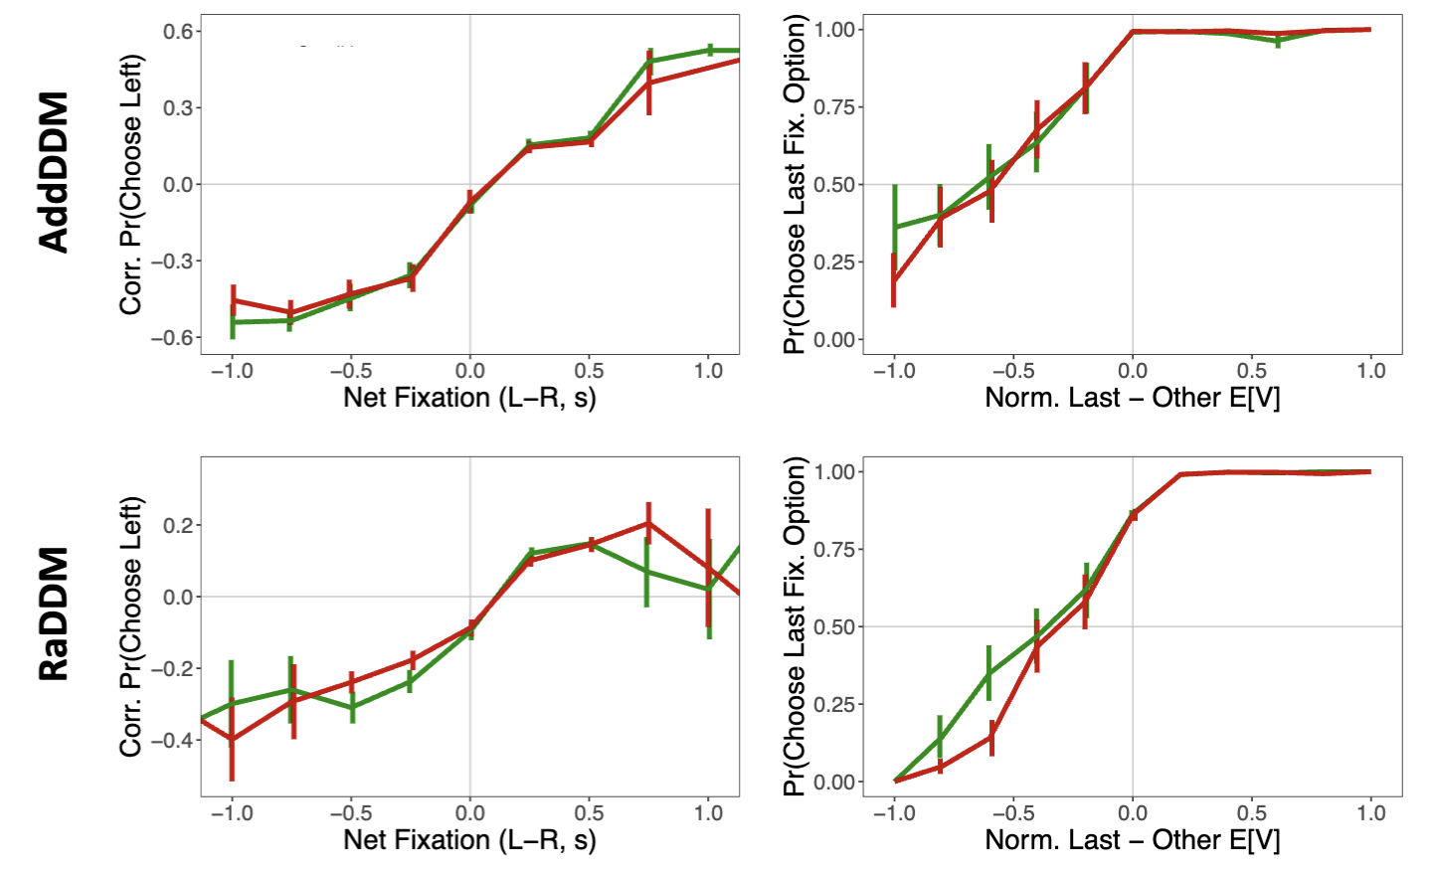
Simulations show there are two variations of the aDDM that can explain our data.
Additive Model of Attention
aDDM with Reference-Dependent Value Signals

Slide 33
Why these two models?
Additive Model of Attention
There is a debate between value-dependent and value-independent attentional effects in the literature [Cavanaugh et al. (2014, J Exp Psych Gen)].
Smith and Krajbich (2019, Psych Sci) showed that it fails to capture some relationships between RT and OV, but we showed that it is capable of explaining our observed attentional biases.

Slide 34
Why these two models?
aDDM with Reference-Dependent Value Signals
Normalization of value signals
Padoa-Schioppa (2009) Range normalization
Frydman and Jin (2022) Normalization can occur within limited trials
Rangel and Clithero (2012) Review of normalization
Other papers mentioned in Frydman and Jin (read and add)
Tobler, Fiorillo, and Schultz (2005), Carandini and Heeger (2012),
Div norm stuff: Louie and Glimcher (2012), Khaw, Glimcher, Louie (2017), Ryan has some papers on this too
Soltani, De Martino, Camerer (2012)

Slide 35
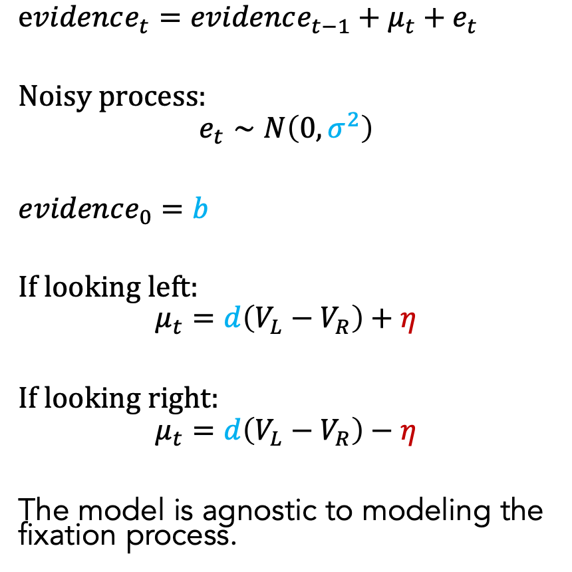
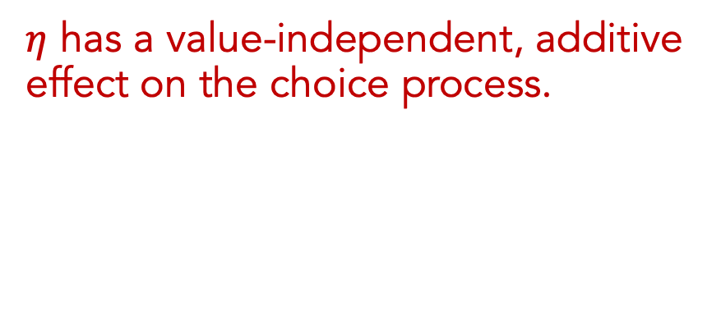
Additive Model of Attention (AddDDM)
$evidence_{t}=evidence_{t−1}+μ_{t}+e_{t}$
Noisy process:
$$e_{t}∼N\left(0, σ^{2}\right)$$
$evidence_{0}=b$
If looking left:
$$μ_{t}=d\left(V_{L}−V_{R}\right)+η$$
If looking right:
$$μ_{t}=d\left(V_{L}−V_{R}\right)−η$$
The model is agnostic to modeling the fixation process.
$η$ has a value-independent, additive effect on the choice process.
Notes:
noisy
bias
drift: ddm in value based decisions: evidence accumulated is value comparison
drift
sim
explain fixation sampling process

Slide 36
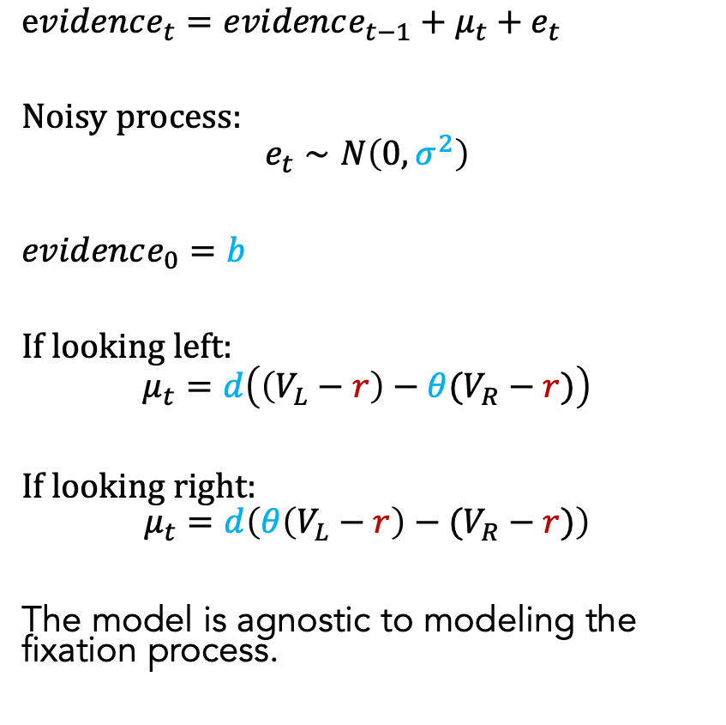
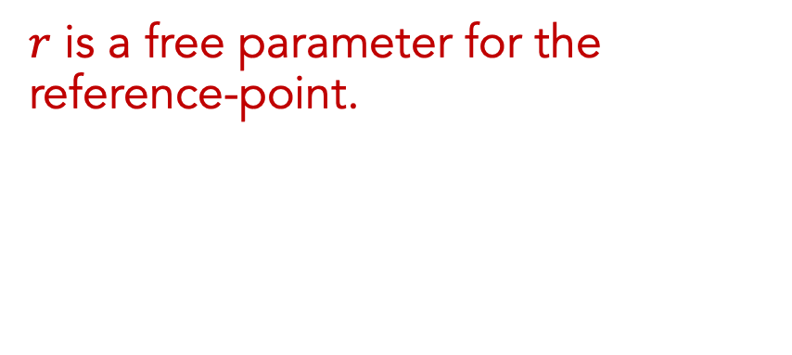
Reference-Dependent aDDM (RaDDM)
$evidence_{t}=evidence_{t−1}+μ_{t}+e_{t}$
Noisy process:
$$e_{t}∼N\left(0, σ^{2}\right)$$
$evidence_{0}=b$
If looking left:
$$μ_{t}=d\left(\left(V_{L}−r\right)−θ(V_{R}−r)\right)$$
If looking right:
$$μ_{t}=d\left(θ\left(V_{L}−r\right)−(V_{R}−r)\right)$$
The model is agnostic to modeling the fixation process.
$r$ is a free parameter for the reference-point.
Notes:
noisy
bias
drift: ddm in value based decisions: evidence accumulated is value comparison
drift
sim
explain fixation sampling process

Slide 37
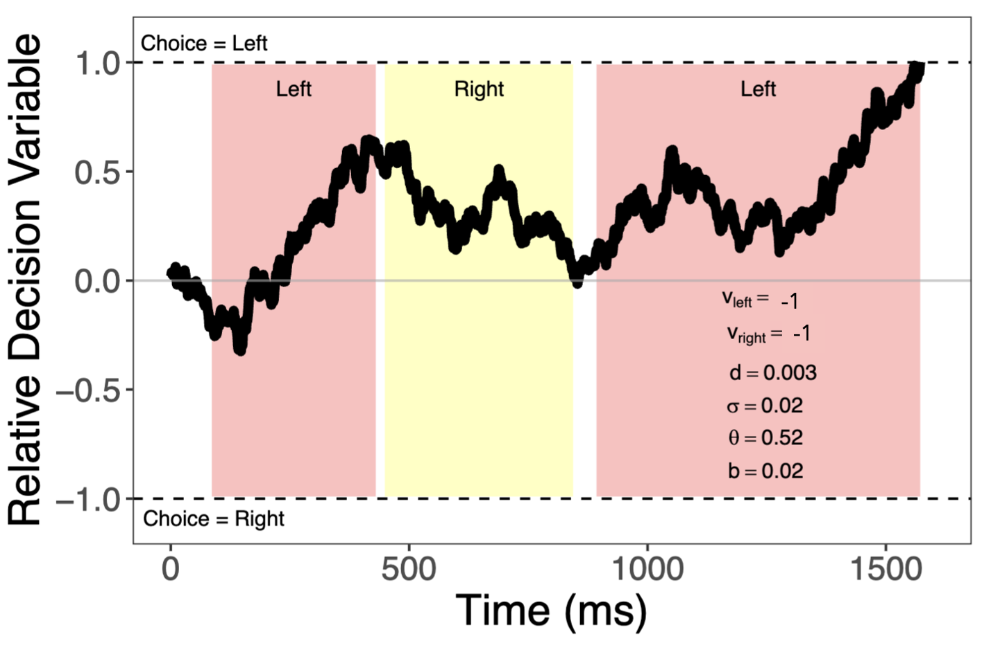
RaDDM in Losses

Slide 38
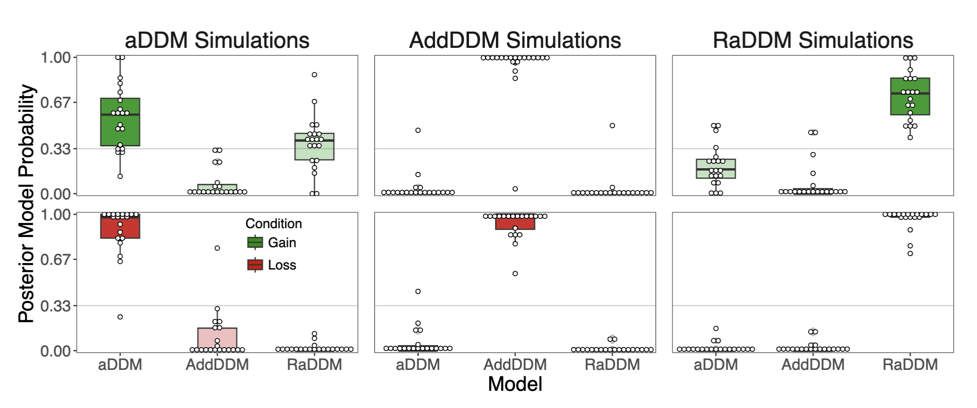
The models are recoverable.

Slide 39
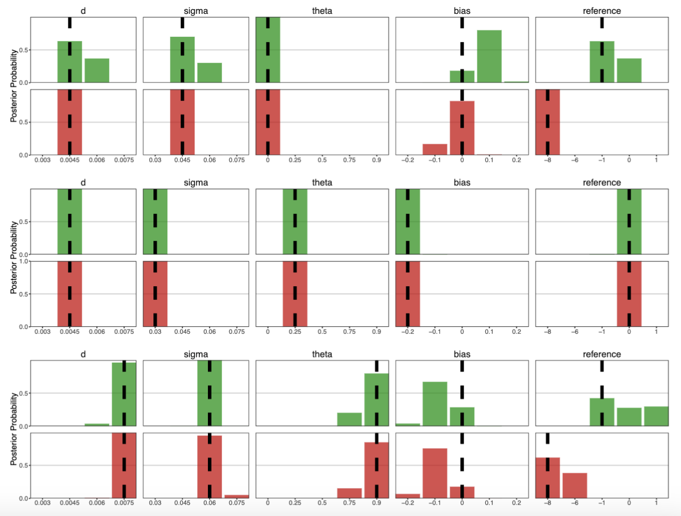
RaDDM successfully recovers parameters.

Slide 40
RaDDM successfully recovers parameters.
How do we pick between the AddDDM and RaDDM?

Slide 41
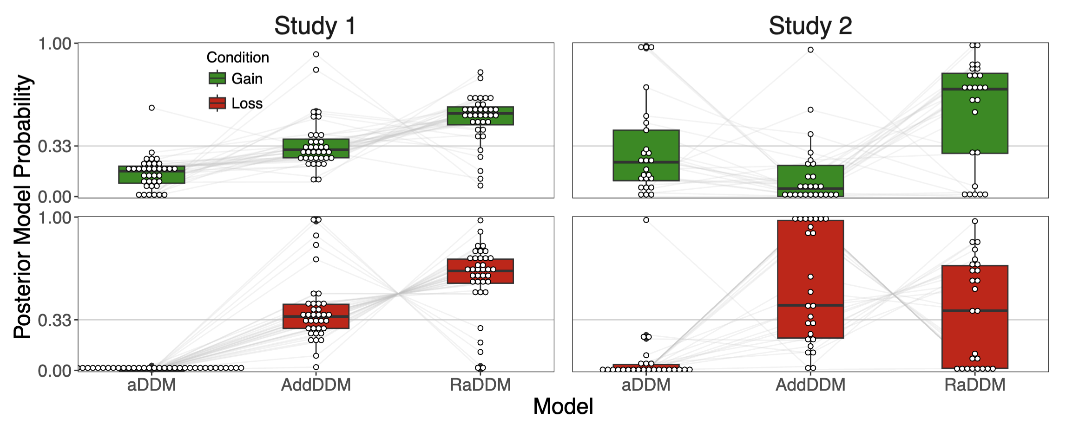
Model comparison favors RaDDM, but not convincingly.

Slide 42
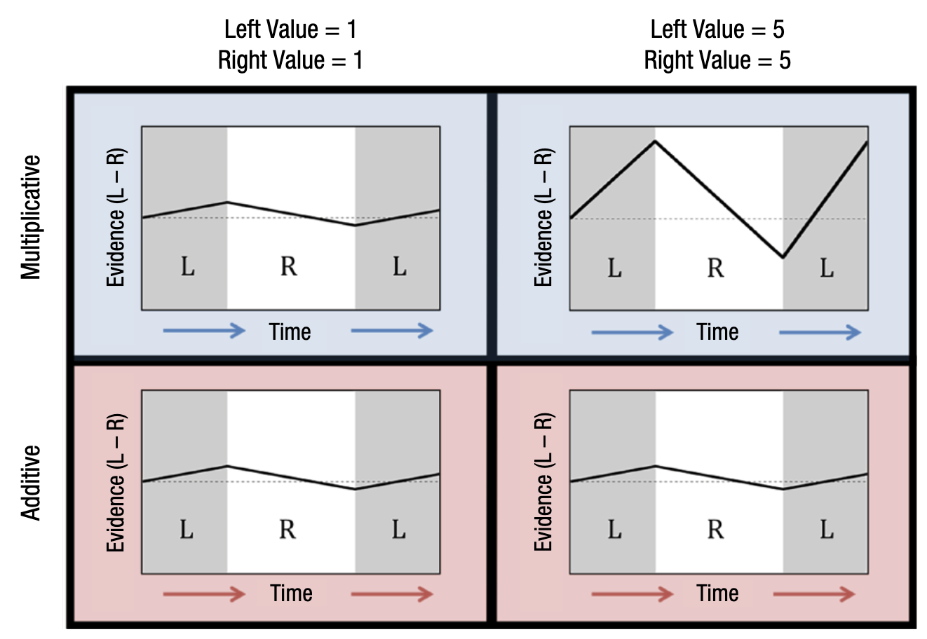

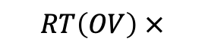

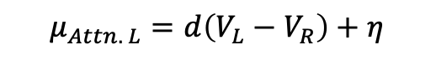
Behavioral Signature: RT(OV) in Losses
$$μ_{Attn. L}=d(V_{L}−θV_{R})$$
$$RT\left(OV\right)↓$$
$$RT\left(OV\right) ×$$
$$μ_{Attn. L}=d\left(V_{L}−V_{R}\right)+η$$
Smith, Krajbich (2019, Psych Sci) Fig. 2

Slide 43

Behavioral Signature: RT(OV) in Losses
-1
-5
-1
-5
$$μ_{Attn. L}=d(V_{L}−θV_{R})$$
$$RT\left(OV\right)↑$$
$$RT\left(OV\right) ×$$
$$μ_{Attn. L}=d\left(V_{L}−V_{R}\right)+η$$

Slide 44
Behavioral Signature: RT(OV) in Losses
-1
-5
-1
-5
If the reference-point in the RaDDM is at or below the minimum value in a condition:
$$RT\left(OV\right)↓$$
$$RT\left(OV\right) ×$$

Slide 45
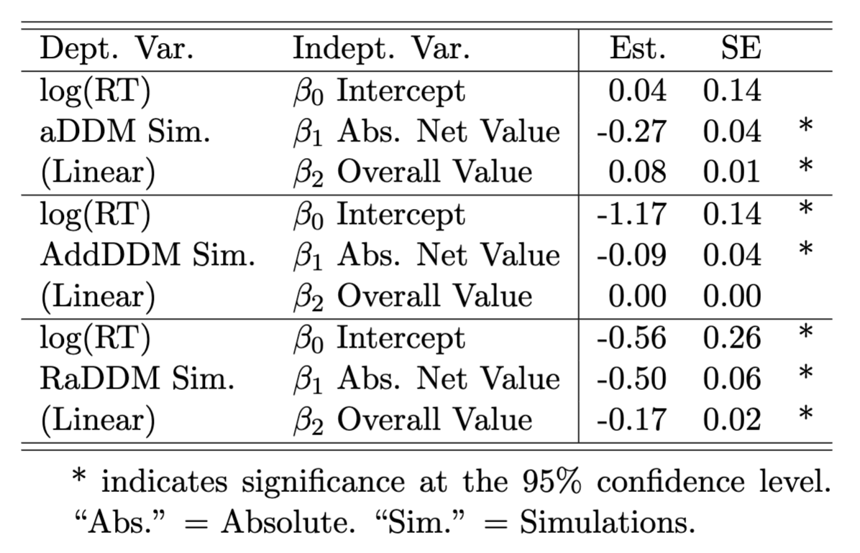
Simulated $\log\left(RT_{Loss}\right)\sim β_{0}+β_{1}\left|V_{L}−V_{R}\right|+β_{2}(V_{L}+V_{R})$

Slide 46
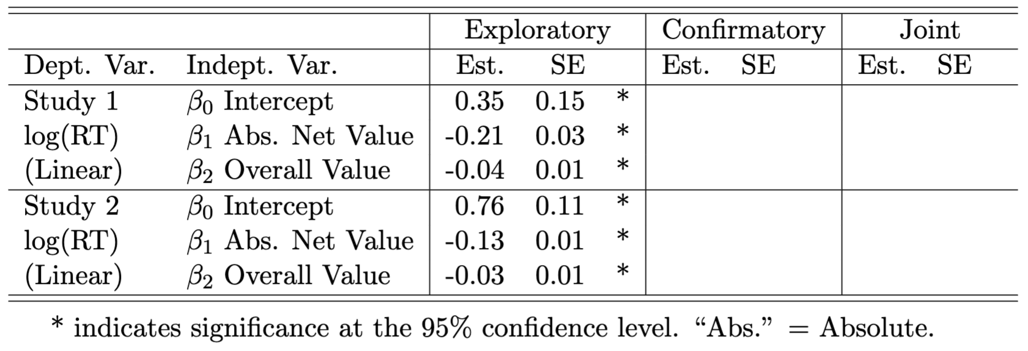
Observed $\log\left(RT_{Loss}\right)\sim β_{0}+β_{1}\left|V_{L}−V_{R}\right|+β_{2}(V_{L}+V_{R})$

Slide 47
Observed $\log\left(RT_{Loss}\right)\sim β_{0}+β_{1}\left|V_{L}−V_{R}\right|+β_{2}(V_{L}+V_{R})$
These results, taken together with our model comparison, suggest that people are using the RaDDM with reference-points at or below the minimum value in a context.

Slide 48
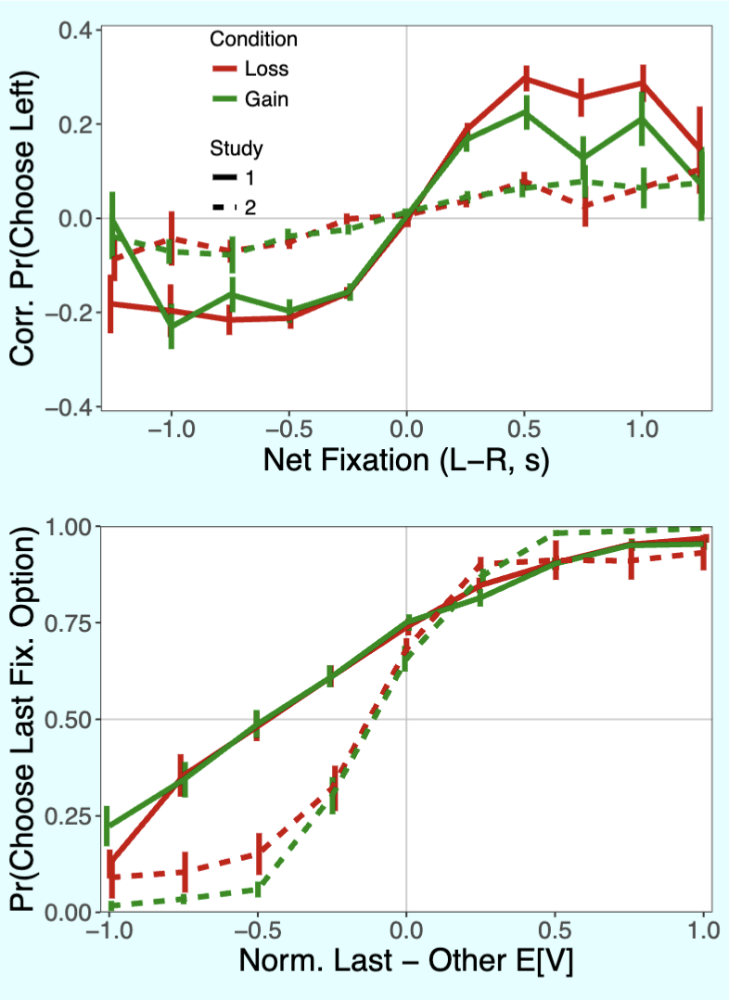
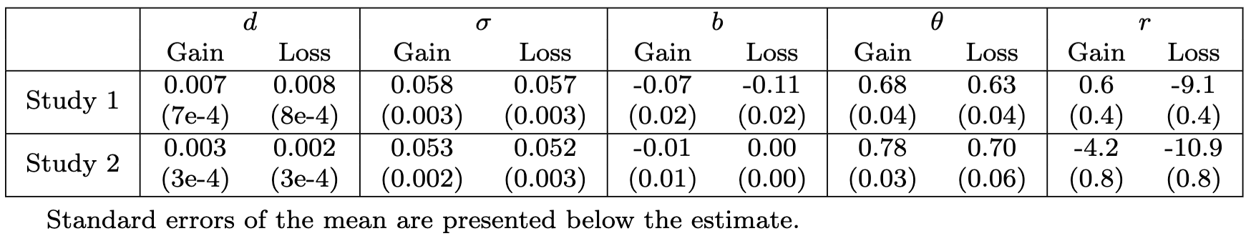
RaDDM: Group-Level Estimates
Observed

Slide 49
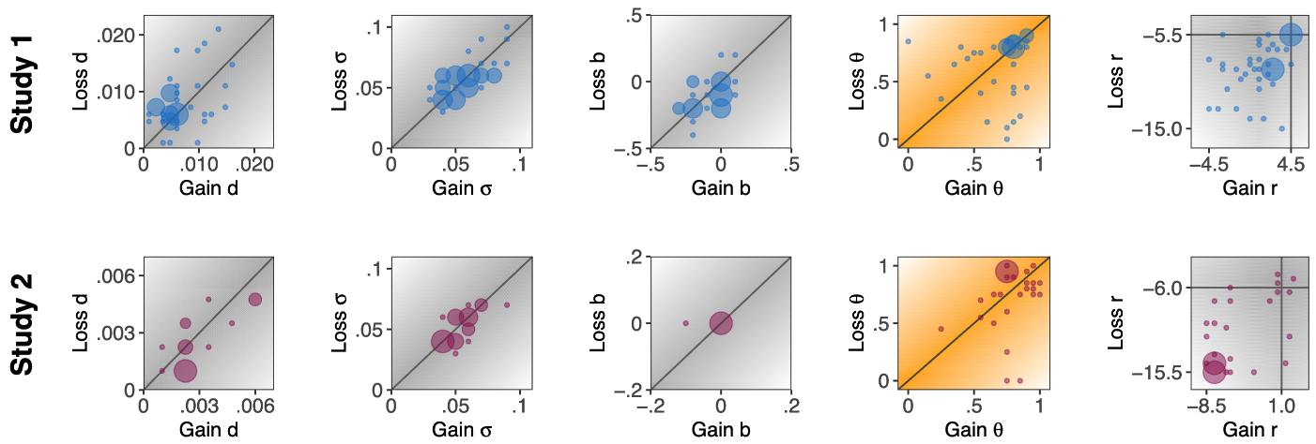
RaDDM: Individual-Level Estimates

Slide 50
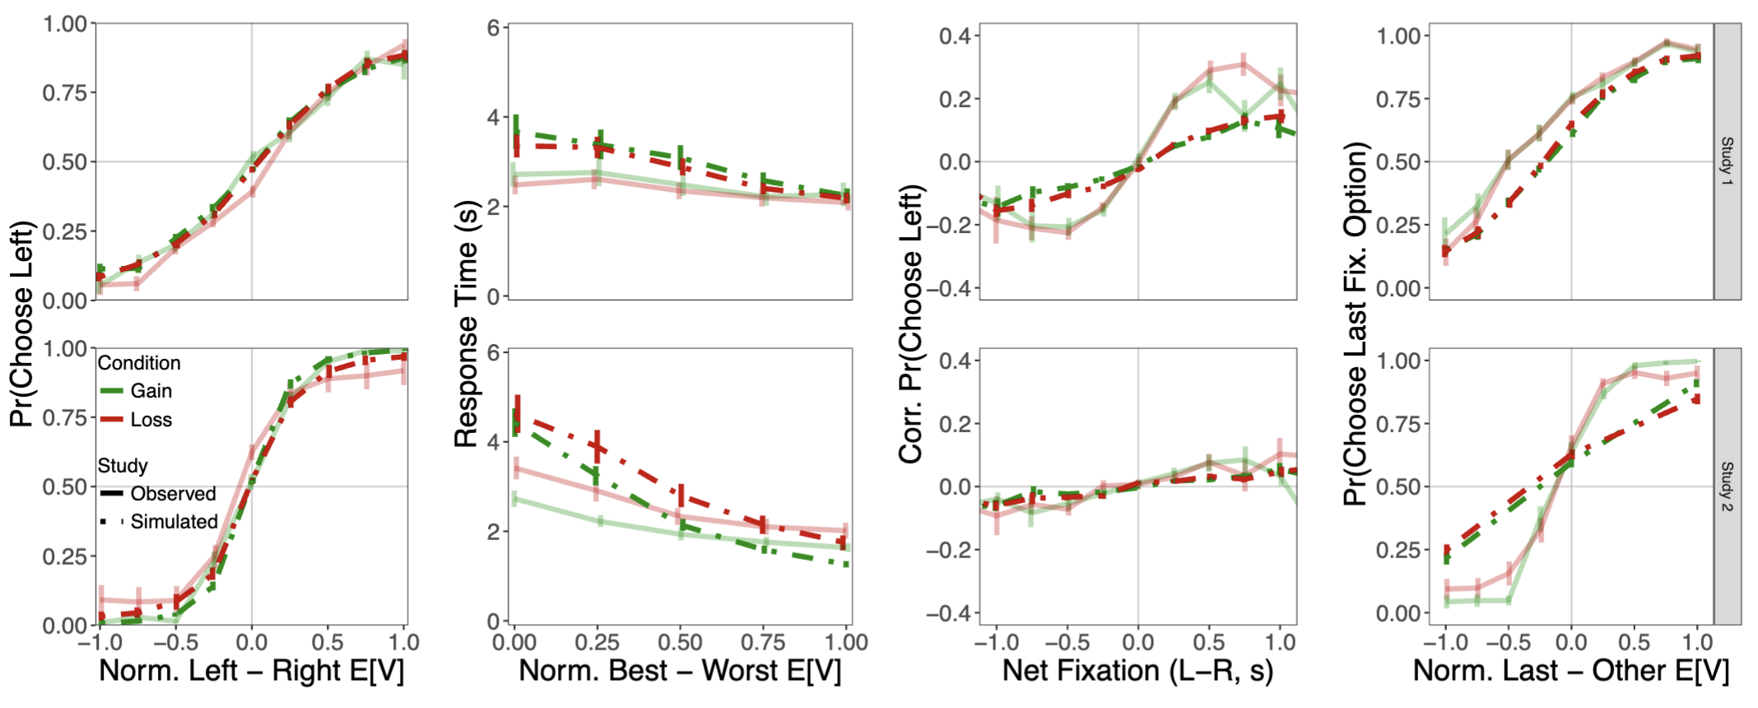
RaDDM: Out-of-Sample Predictive Checks

Slide 51
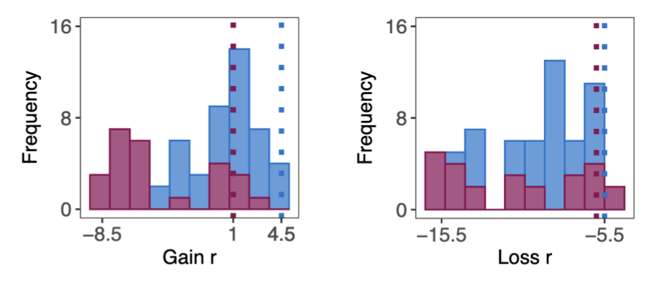
Summary
Attention is pulling choices towards the attended item in both choices between gains and between losses. This is not predicted by the standard aDDM.
Extending the aDDM to include reference-dependent value signals allows us to explain behavior in the loss condition.
People seem to be using reference-points set at or below the minimum value in a given context.

